Slide 1


Prototype Submission Phase

Slide 2
TEAM NAME and MEMBER DETAILS:
Resume Analyser
Afreen Sudheer
THEME:
AI for Career Growth

Slide 3
PROBLEM STATEMENT
Job seekers often face difficulty determining how well their resumes align with job descriptions, while recruiters spend excessive time manually screening applications for relevant skills and experience.
This traditional process is inefficient, subjective, and prone to human error, leading to missed opportunities for both candidates and employers.
There is a clear need for an automated and reliable solution that bridges this gap through intelligent analysis.
The Resume Analyser addresses this problem by leveraging AI to evaluate resumes against job descriptions, highlighting matching skills, identifying missing keywords, and providing clear improvement suggestions..

Slide 4
SOLUTION
The Resume Analyser is an AI-powered agent built on the Agent.ai platform that automatically evaluates the similarity between a candidate’s resume and a job description. It provides an alignment report with matching skills, missing keywords, and suggestions to enhance compatibility with the target role.
Impact Metrics:
Reduction in resume screening time (up to 80%)
Improved resume–JD relevance score
Higher interview shortlisting rates
Frameworks / Tools / Technology Stack:
Platform: Agent.ai (No-code workflow builder)

Slide 5
SOLUTION (Contd.)
AI Model: Claude Opus 4.7
Input Types: Resume (PDF), Job Description (text input)
Assumptions / Constraints:
Text-based resumes (not image scans) for accurate parsing
Works best in English language
Scalability & Usability:
Easily scalable for recruiters, job portals, and universities for career readiness programs.
Minimal setup required—entirely browser-based.

Slide 6
METHODOLOGY
User
Upload Resume
Workflow Diagram
User uploads resume (PDF).
User pastes job description text.
Agent combines inputs and creates formatted dataset.
Claude Opus 4.7 analyses alignment and generates structured report.
Output displayed with matching and missing skills, and improvement suggestions.
Input JD
Combine Data
Claude Opus 4.7 Analysis
Generate Report
Display Output

Slide 7
METHODOLOGY (Cont.d)
Core Concept & Components
Concept: AI-assisted career optimization
Principles: Natural Language Understanding (NLP), semantic similarity detection, keyword extraction
Elements: Resume parser, job description analyser, comparison engine, output renderer

Slide 8
WORKING PROTOTYPE
Live Agent: - [View Live Agent]
Demo :- [View Video Demo]

Slide 9
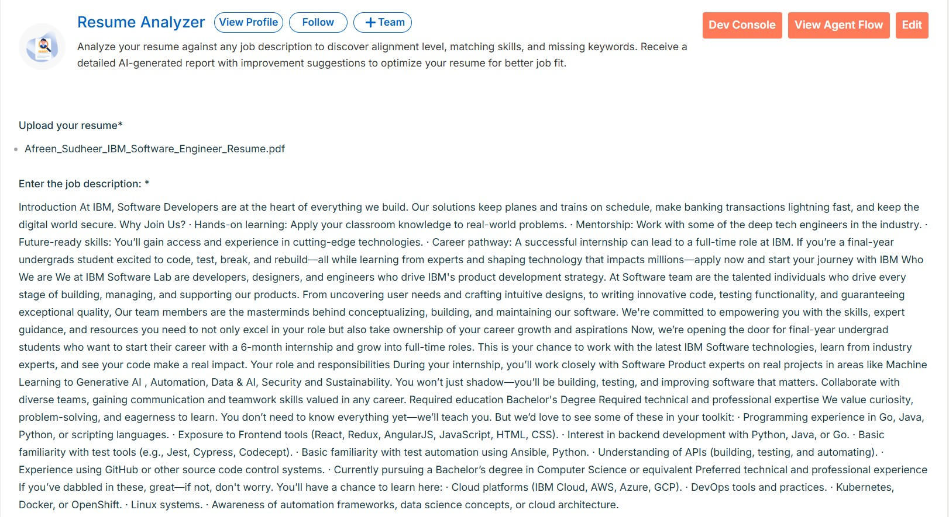
Attachments
Inputs (Resume & Job Description)

Slide 10
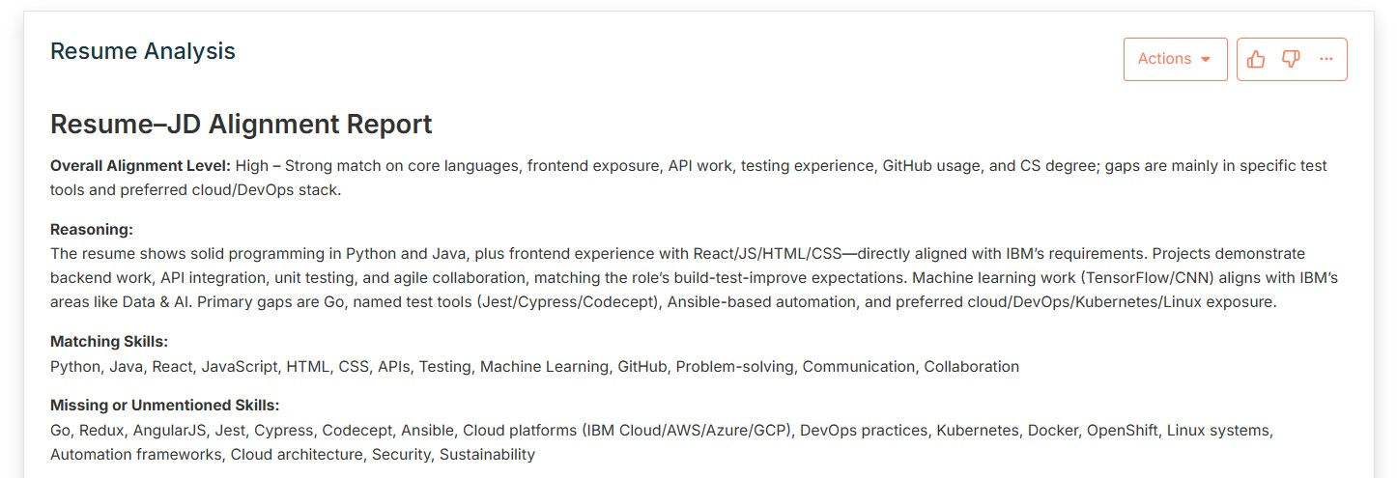
Attachments (Contd.)
Outputs (Resume Alignment Summary)

Slide 11
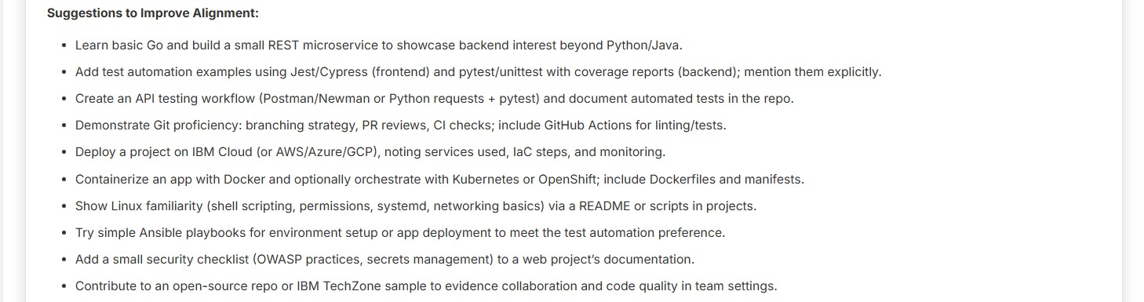
Attachments (Contd.)
Output (Improvement Suggestions)

